Slide 1
CLC – Day 4
Flask

Slide 2
Creating a Flask Web Application
Flask is a powerful and flexible micro web framework for Python.
Ideal for both small and large web projects.

Slide 3
Set up a Flask Project
Create a folder FlaskExample
Open the folder FlaskExample in VS Code
Create a virtual environment (Optional)
python -m venv venv
.\venv\Scripts\activate
Add dependencies
python -m pip install Flask

Slide 4
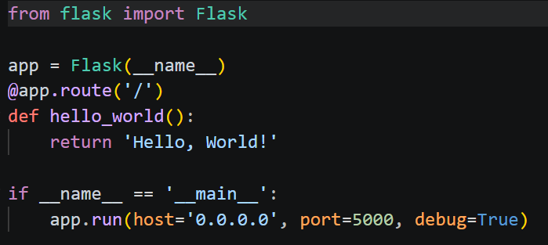
Initiate the Flask project
Create development server and display “Hello World!“ in the browser.
Create a file named app.py inside FlaskExample folder and type in the below code.

Slide 5
Functions like hello_world() are called views in Flask.
Run this file.

Slide 6
Adding Package structure
Create a folder named “EnviornmentMonitor” inside FlaskExample
Move the app.py into EnviornmentMonitor
Rename app.py into __init__.py
FlaskExample/
│
└── Environement Monitor/
└── __init__.py

Slide 7
Run the Flask project using the below command.
python -m flask --app EnvironementMonitor run --port 8000 –debug
You’re telling Flask to look for an app named EnvironementMonitor and serve it in debug mode on port 8000
visit http://localhost:8000

Slide 8
Application Factory
An application factory in Flask is a design pattern that’s highly beneficial for scaling Flask projects.
Instead of having your application’s code at the root level of your __init__.py file, you’ll work with a function that returns your application.

Slide 9
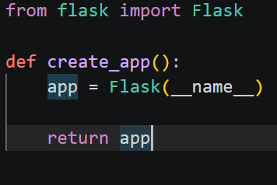
Application Factory
Replace the content of __init__.py with the content below
Function named create_app() initializes the app and returns it.
The create_app() function is your application factory.

Slide 10
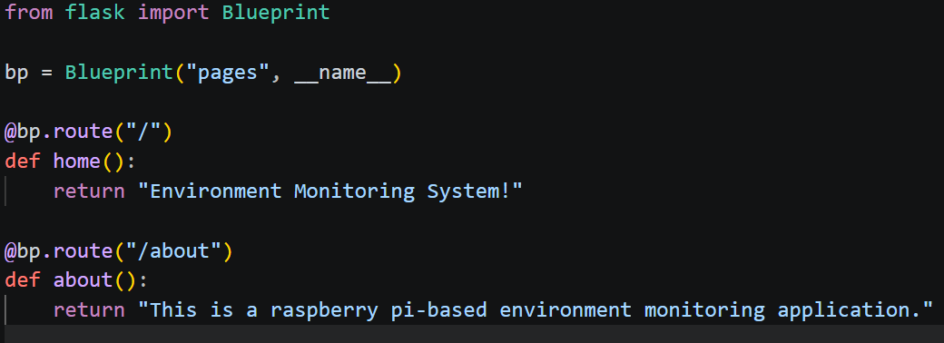
Blueprints
Blueprints are modules that contain related views that you can conveniently import in __init__.py
Create blueprints that you register in your application factory.
Create a file named pages.py in the EnvironmentMonitor/ folder and add the content below

Slide 11

Bp is an instance of Blueprint.
The first argument, "pages", is the name of your blueprint.
You’ll use this name to identify this particular blueprint in your Flask project.
The second argument is the blueprint’s __name__.

Slide 12
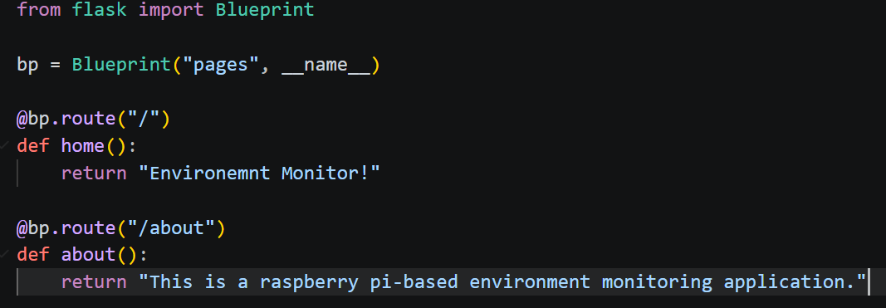
Leverage Blueprints
Blueprints are modules that contain related views that you can conveniently import in __init__.py
Create a file named pages.py in the board/ folder and add the content below:

Slide 13
visit http://localhost:8000/about

Slide 14
Templates
Templates are HTML files with the capability of rendering dynamic content sent over from your Flask views.
Flask uses the popular Jinja template engine, which you already installed as a dependency when you installed Flask.
With a template engine like Jinja, you can embed Python-like expressions into your templates to create dynamic web content
Jinja also supports template inheritance, allowing the creation of a base template that you can extend in child templates.

Slide 15
Git Hub Repository for the template-based Web Application code
https://github.com/nisharanipraveen/FlaskExample.git

Slide 16
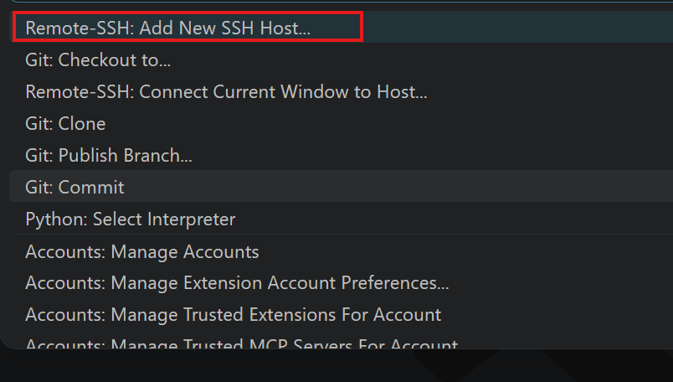
Raspberry Pi
Open VS code
Ctrl+Shift+P
ssh usr@hostname
Ex: ssh pi@rasoberrypi

Slide 17
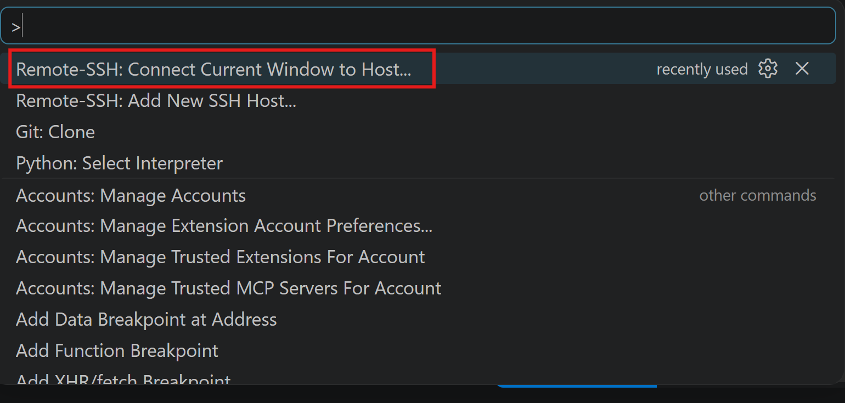
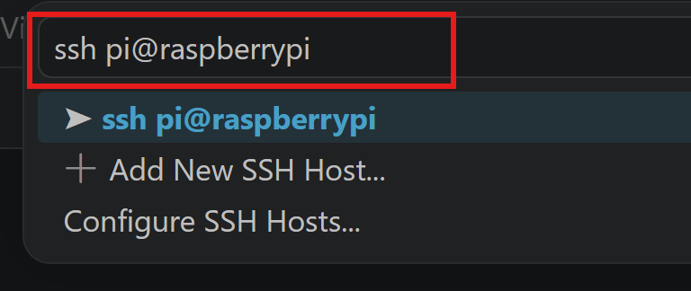
Raspberry Pi
Ctrl+Shift+P

Slide 18
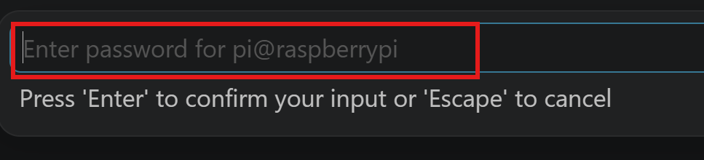
Raspberry Pi

Slide 19
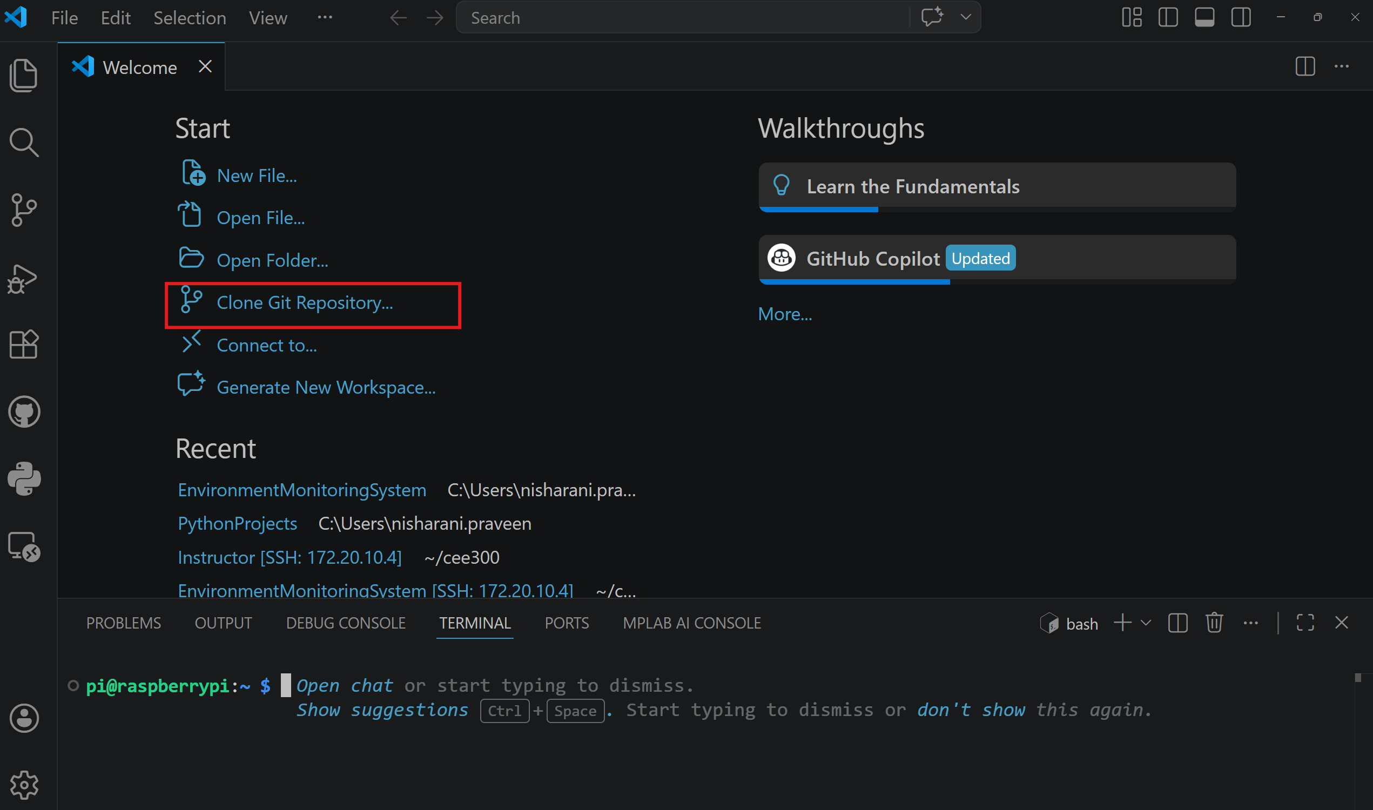
Raspberry Pi

Slide 20
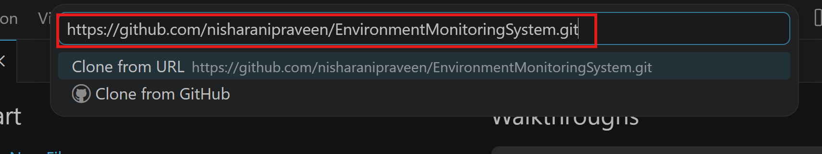
Raspberry Pi

Slide 21
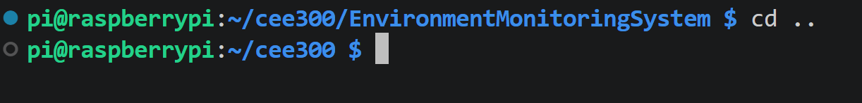
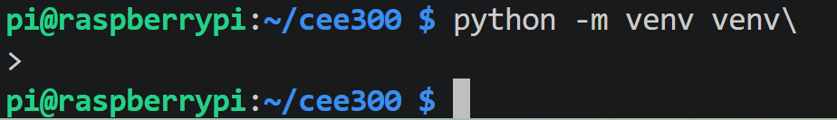
Raspberry Pi

Slide 22
Raspberry Pi
sudo apt update
sudo apt install libopenblas-dev
pip uninstall numpy -y
pip install numpy
python -m flask --app EnvironmentMonitoringSystem run --port 8000 --debug

Slide 23
Raspberry Pi
If the ssh fails,
Go to C:\Users\<your account>\.ssh\ folder in your computer
Open known_hosts in Notepad and delete the contents in that.
Now, try adding ssh host from your VS Code
If LOPES does not work, enable the “Mobile Hotspot” and connect your laptop and the RaspberryPi to the mobile hotspot.

Slide 24
Questions

